Slide 1
Course Syllabus & Overview of LLMs
Workshop on Building AI Agents
Henry Kautz
Spring 2026

Slide 2
Course Goals
Learn how to build AI agents: systems powered by large-language models that autonomously interact with services, tools, and other agents
Required accounts:
Claude Pro with Claude Code
Hugging Face
Google Colab
GitHub
Free or discounted student accounts available

Slide 3
These Be The Rules
Grading
25% class participation
20% mid-term and final portfolio review
55% final project, including polished 10-minute video presentation mp4
Attendance is mandatory
Acceptable excuses for missing class:
Illness (notify me as soon as possible)
Travel for UVA sports teams (notify me as early as known)
Job interviews (notify me as early as known)
Not acceptable as excuses
Leaving for breaks early or returning late
Pressure of other course deadlines

Slide 4
Portfolio
Save your work in archive on GitHub
Sign up for one-on-one review of your portfolio and to discuss ideas for your final project the week before spring break
Final projects including recorded & edited video presentation due on April 16 – two weeks before the end of classes!

Slide 5
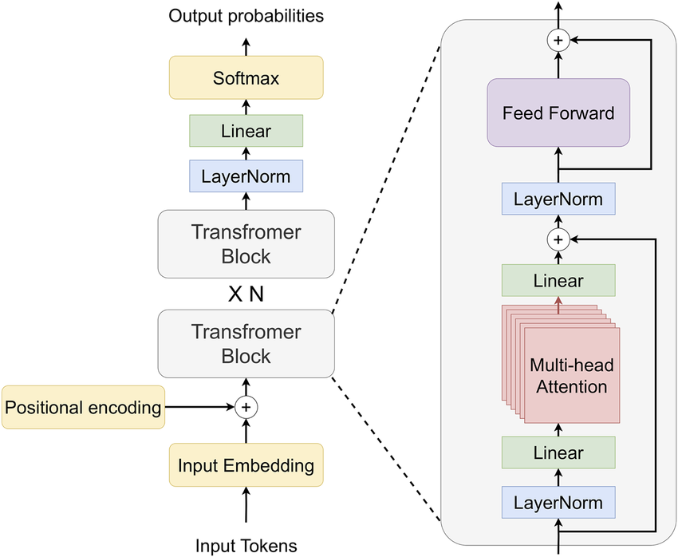
Decoder-only LLM
Given input sequence, generate the next token
How does it generate multiple output tokens?
After generating first token, append it to the input token sequence. Then generate second token.
Repeat until transformers decides to generate ”end of output” token.

Slide 6
Decoder-only LLM
What are tokens?
Word pieces. Computed offline using an algorithm similar to text compression
Why not use words as tokens?
Smaller token table, and supports an unlimited vocabulary

Slide 7
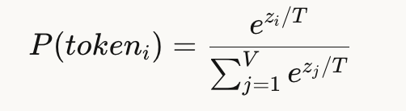
Decoder-only LLM
How is a token generated given output probabilities over token?
Controlled by temperature T
T=1 normal distribution
T=0 max
T>1 more random

Slide 8
Decoder-only LLM
How can we easily make a model smaller and faster?
Replace 64-bit floating point numbers with highly quantized numbers
4-bits – typically only 2% reduction in quality
Each weight replaced by an integer -8 to +7
Each group of 32 weight receives a different scale to map back to floating point

Slide 9
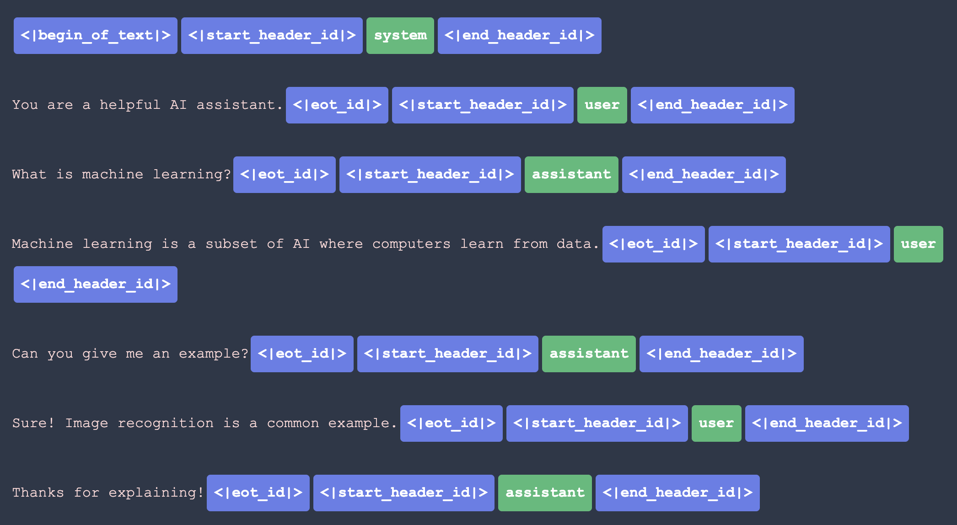
Tokenizing a multi-turn conversation

Slide 10
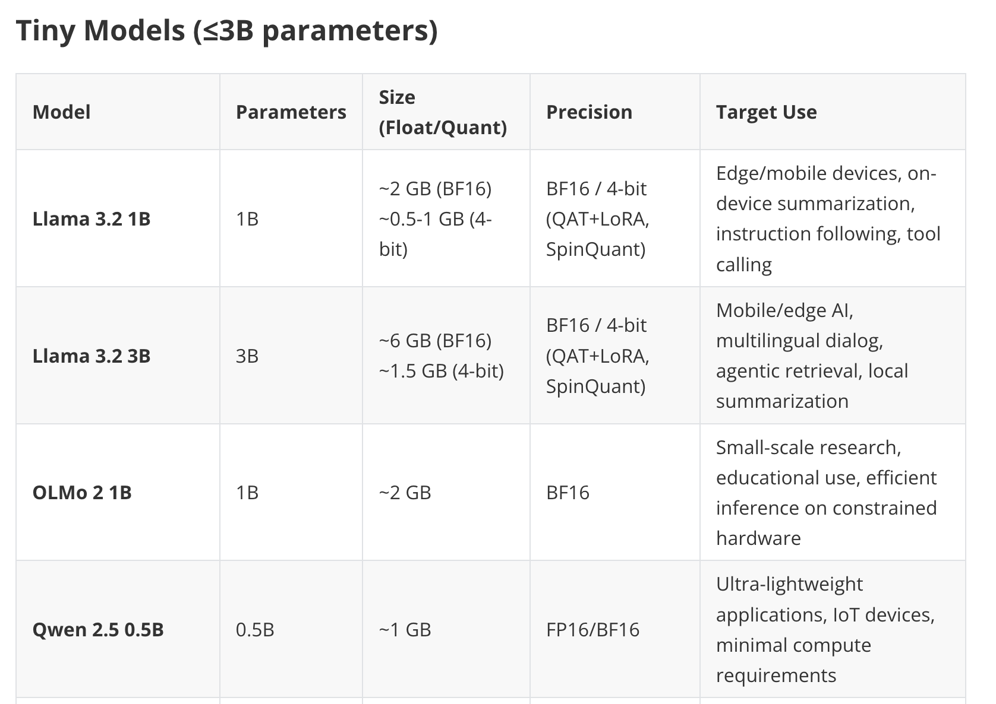

Slide 11
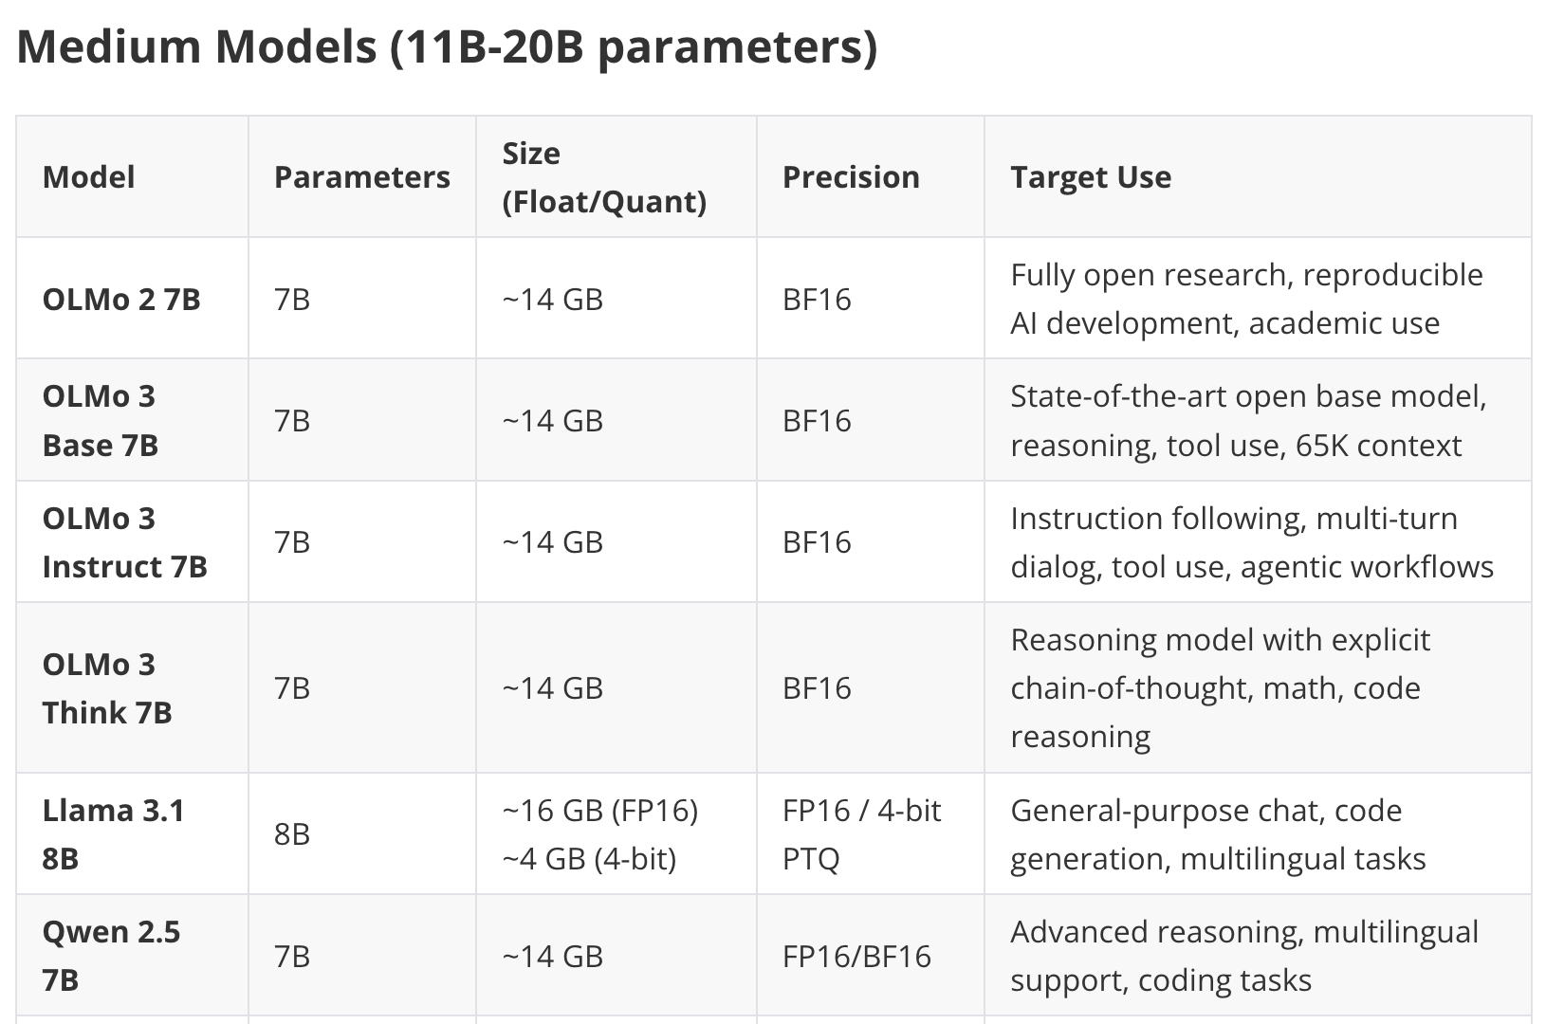

Slide 12
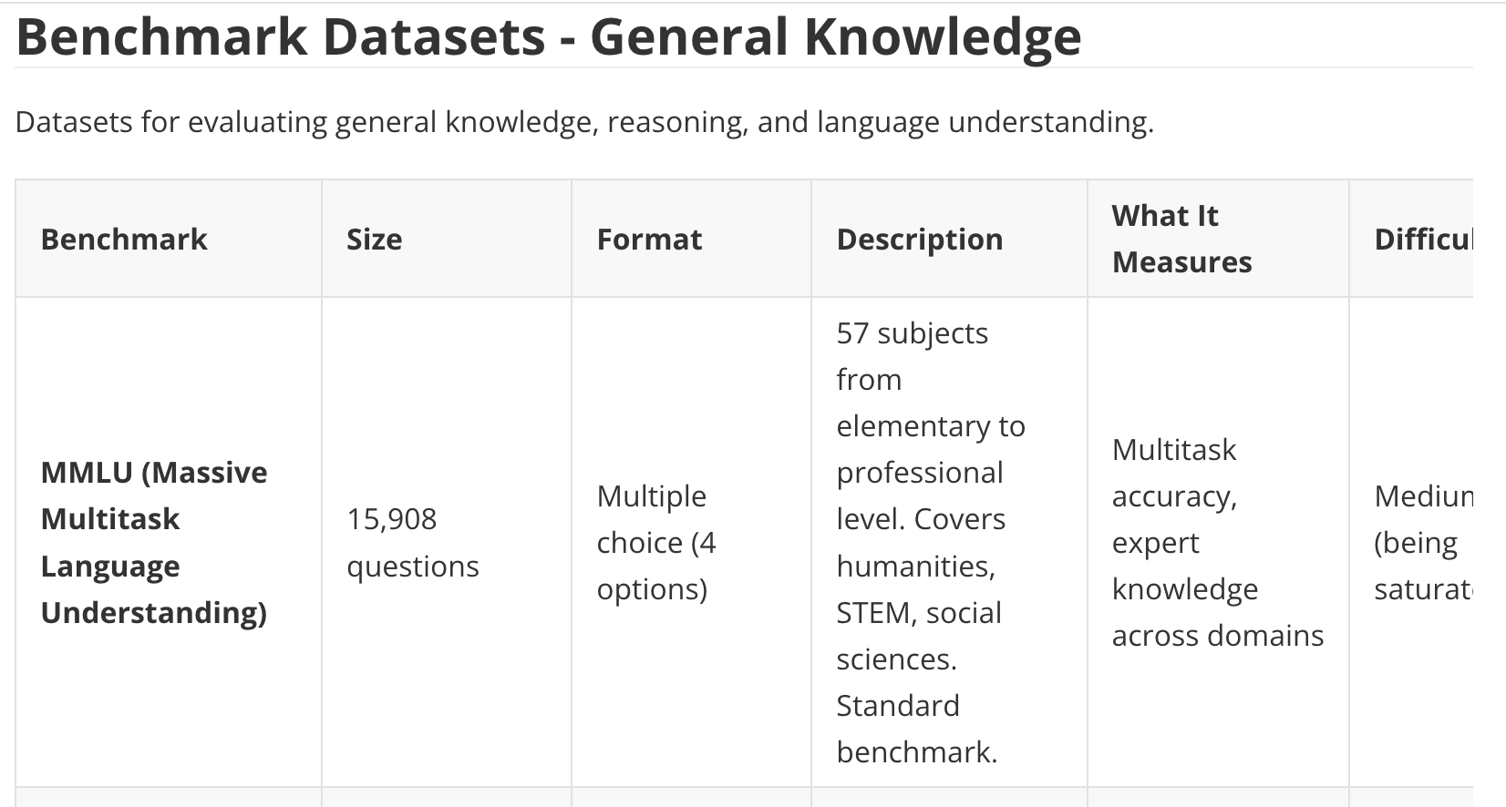

Slide 13

A Simple Chat Agent
LLM
Conversation History

Slide 14
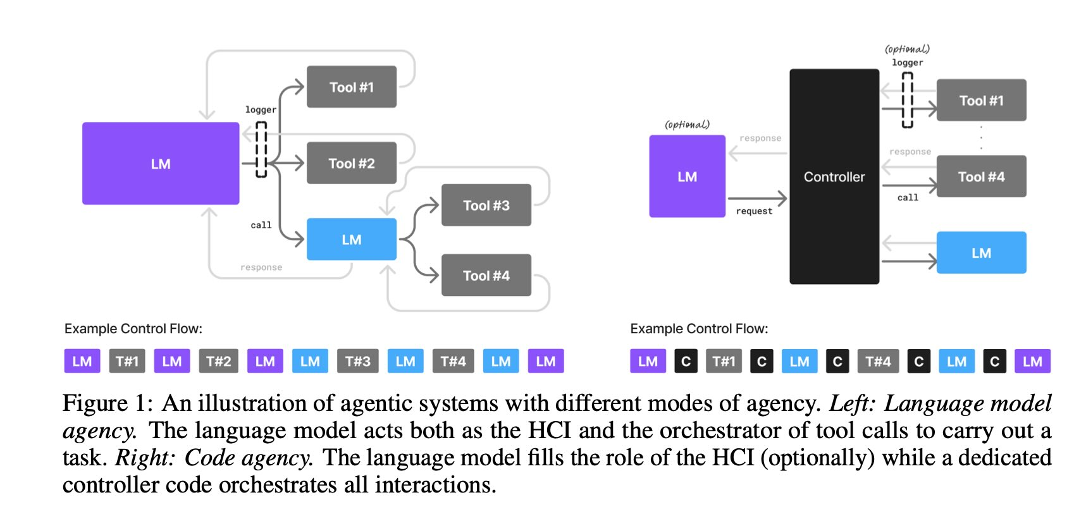

Slide 15
Running an LLM, Class 2
Part 1: No student left behind!
Do you need help?
Can you offer help?
Goal: everyone can
Run Llama on their laptop
Run at least one other LLM on their laptop
Ditto for Google CoLab
Part 2: Interlude: Small Language Models Are The Future
Part 3: Continue on ahead
Experiments, results, graphs
Chat agent
Results in your GitHub portfolio archive

